Slide 1
Marmaray Feneryolu Station
November 9, 2016
YEGOO DESIGN

Slide 2

Outline
Introduction
Design Criteria
Roof Design
Slab Design and Alternatives
Column Design
Geotechnicalical Properties and Foundation Design

Slide 3
INTRODUCTION

Slide 4
Project in numbers
Total length: 76.6 km
Total stations: 40
Passengers per hour : 75,000
Target: 1.5 million passengers per day

Slide 5
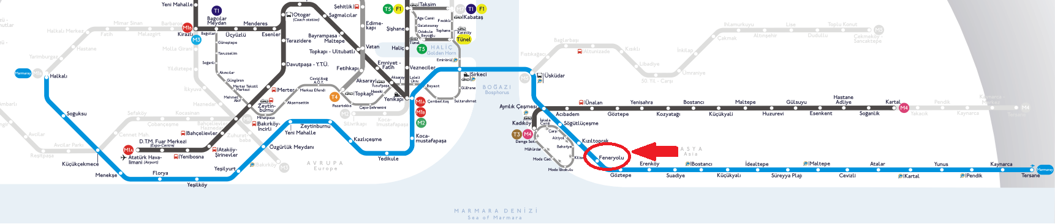
Location
(https://upload.wikimedia.org/wikipedia/commons/0/0f/Marmaray_Istanbul_Project.png)

Slide 6
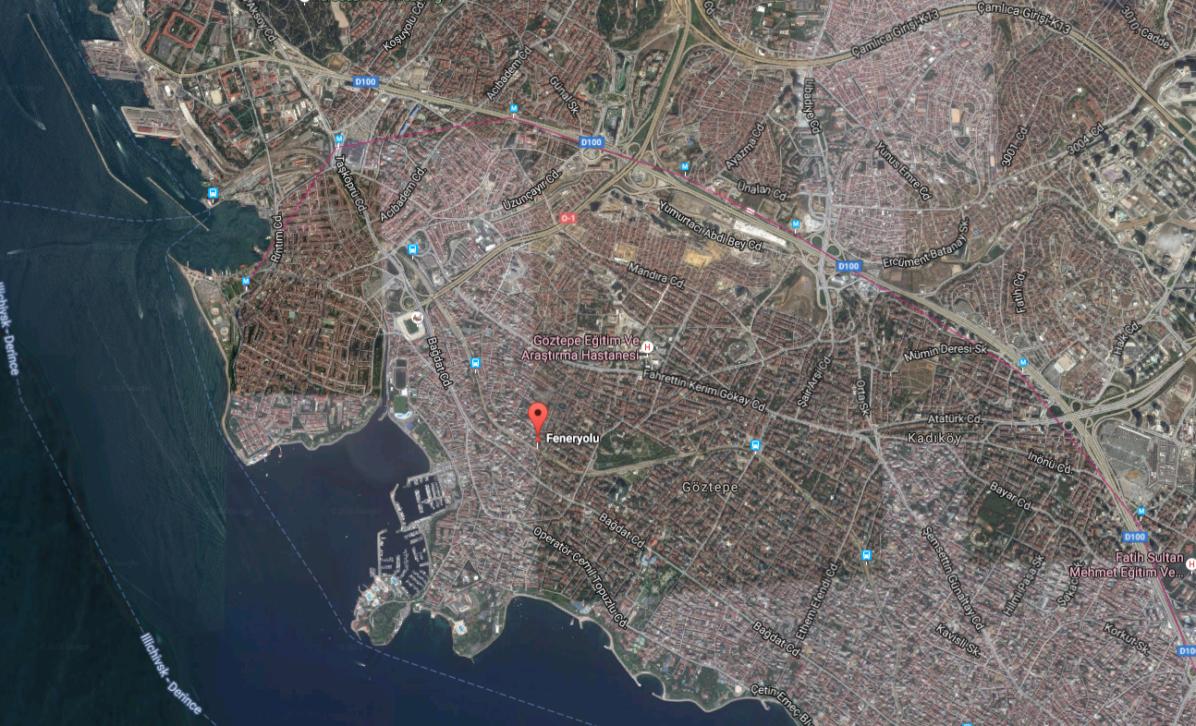
Kadıköy – Feneryolu Marmaray Station
(https://www.google.de/maps/place/Feneryolu/@40.9794607,29.045282,877m/data=3m2!1e3!4b1!4m5!3m4!1s0x14cac780c8073283:0xf951677e7d96b385!8m2!3d40.9794607!4d29.0474707!)

Slide 7
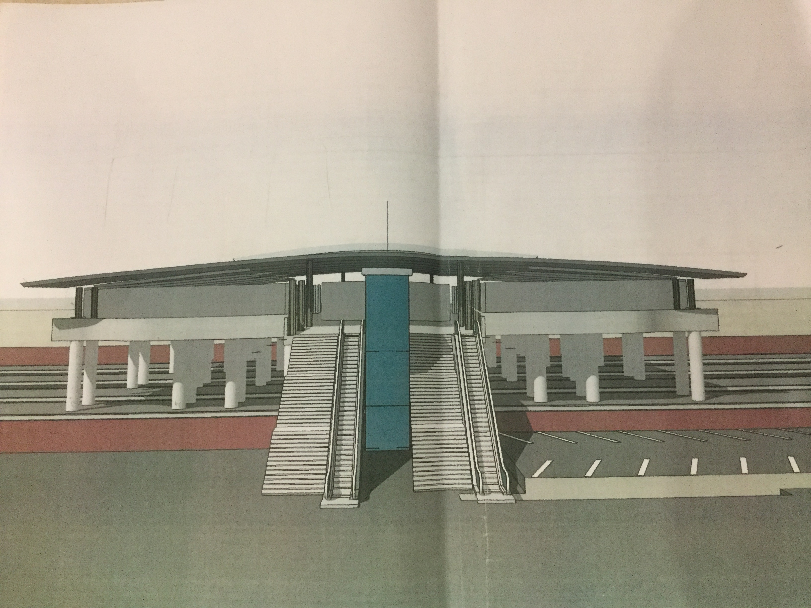
3D VIEW

Slide 8
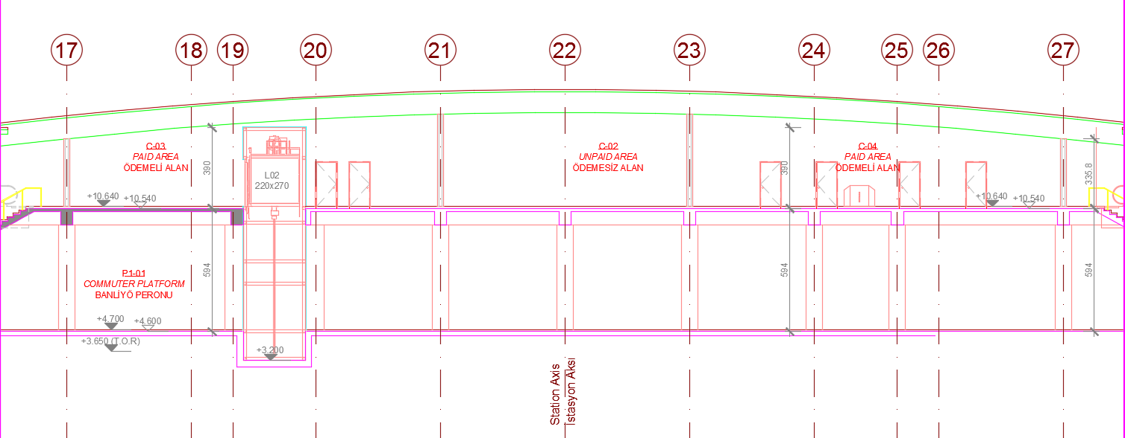
Section View

Slide 9
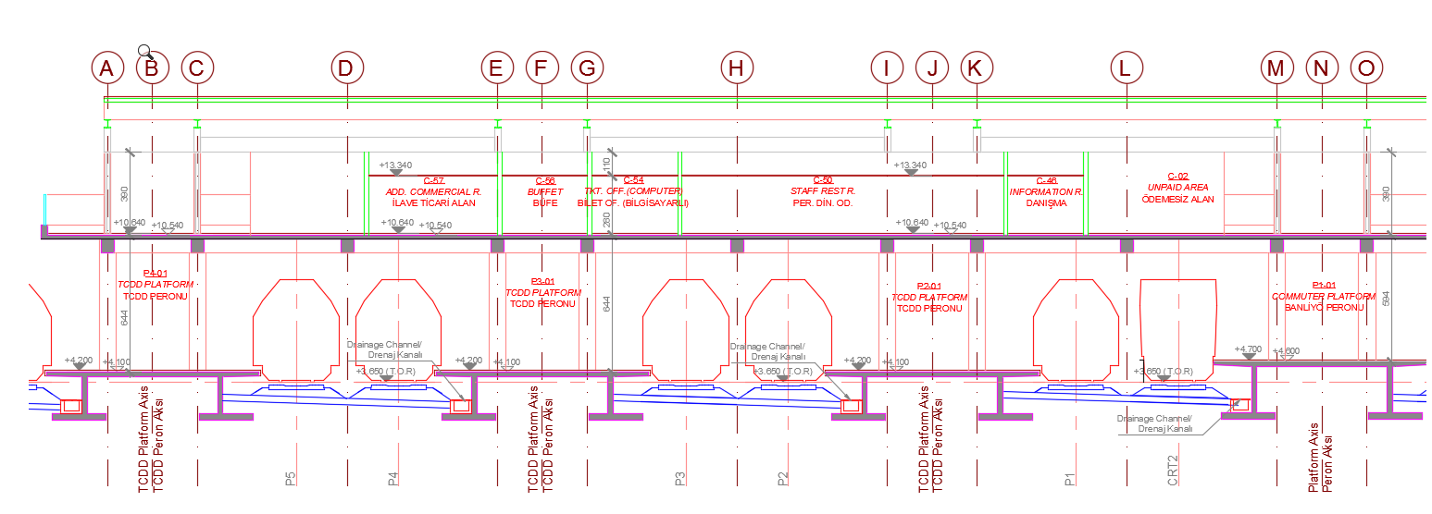
Side View

Slide 10
DESIGN CRITERIA

Slide 11
Design Criteria
DISCIPLINE | STANDARDS
GENERAL | TS-TURKISH STANDARDS
LOADING | TS498-DESIGN LOADS FOR BUILDING TSC2007-TURKISH SEISMIC CODE TURKISH STATE METEOROLOGICAL SERVICE
CONCRETE DESIGN | TS500-REQUIREMENTS FOR DESIGN AND CONSTRUCTION OF REINFORCED CONCRETE STRUCTURES TSC2007-TURKISH SEISMIC CODE
STEEL DESIGN | DESIGN AND CONSTRUCTION SPECIFICATIONS FOR STEEL STRUCTURES by MINISTIRY OF ENVIORENMENT AND URBAN PLANNING (September, 2016)

Slide 12
Material properties
C30 and S420a
Material factors for Concrete Design
Concrete 1.5
Steel 1.15
S275 and S355 steel members

Slide 13
Design Criteria
Concrete
Ultimate Strength Design (USD)
Steel
Load and Resistance Factor Design (LRFD)

Slide 14
Loads Acting on the Structure
Dead load (G)
Self weight
Additional Dead Loads
Live load (Q)
Roof live load
Floor live load
Snow load (S)
Wind load (W)
Earthquake load (E)
Temperature load (T)

Slide 15
DISCIPLINE | LOAD COMBINATION | SOURCES
CONCRETE DESIGN (ULTIMATE STRENGTH DESIGN) | 1.4G+1.6Q | TS500 TSC2007 Design and Construction Specifications for Steel Structures by Ministry of Environment and Urban Planning (September, 2016)
 | 1.0G+1.2Q+1.2T
 | 1.0G+1.3Q+1.3W
 | 0.9G+1.3W
SEISMIC DESIGN | G+Q±E_{x}±0.3E_{y}
 | G+Q±E_{y}±0.3E_{x}
 | 1.0G+1.0Q+1.0E
 | 0.9G+1.0E
 | 1.2G+1.0Q+0.2S+1.0E
STEEL DESIGN (LOAD AND RESISTANCE FACTOR DESIGN) | 1.4G
 | 1.2G+1.6Q+0.5(Q_{r} or S)
 | 1.2G+1.6(Q_{r} or S) +(Q or 0.8W)
 | 1.2G+1.0Q+0.5(Q_{r} or S) +1.6W

Slide 16
ROOF DESIGN

Slide 17
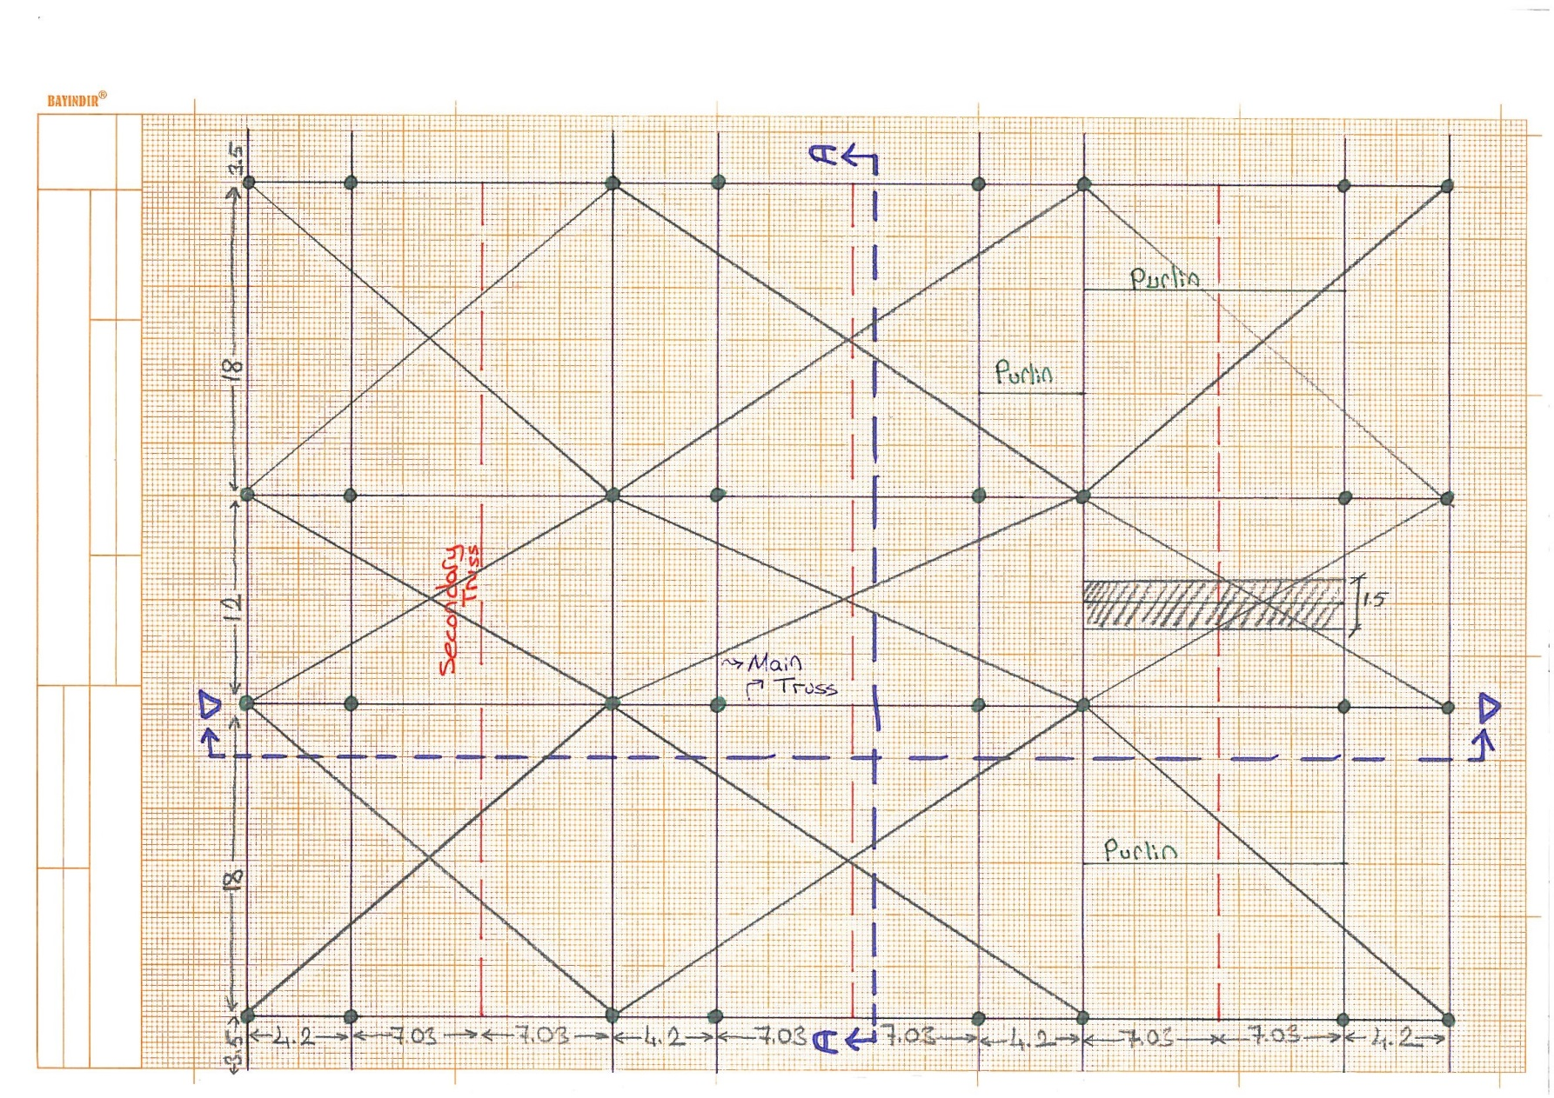
Roof Plan Layout

Slide 18
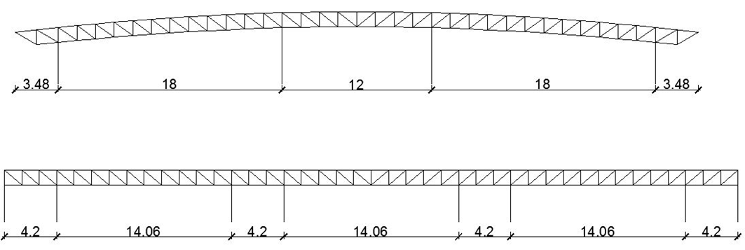
Section A-A & D-D

Slide 19
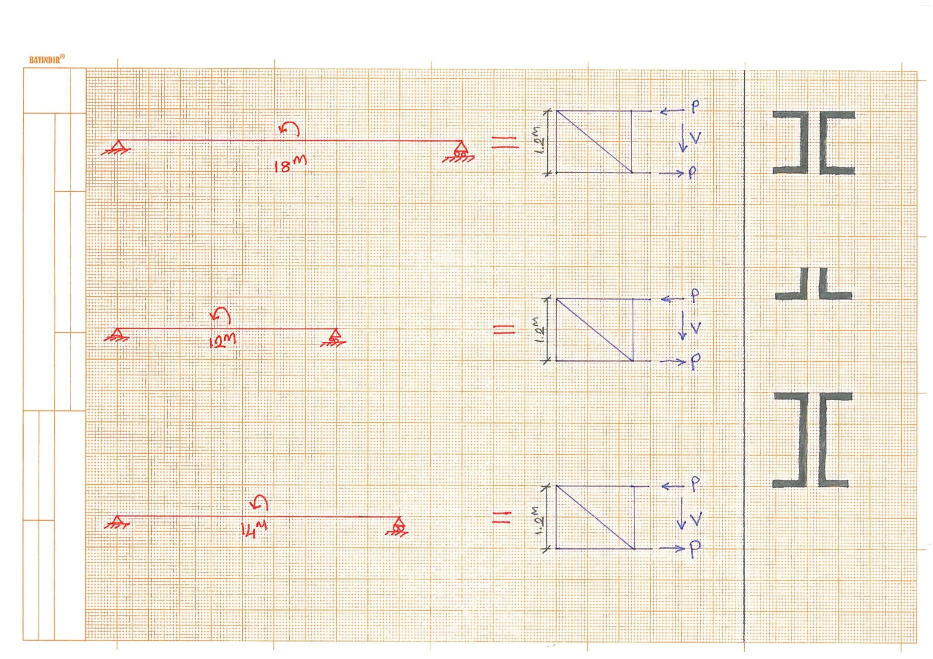
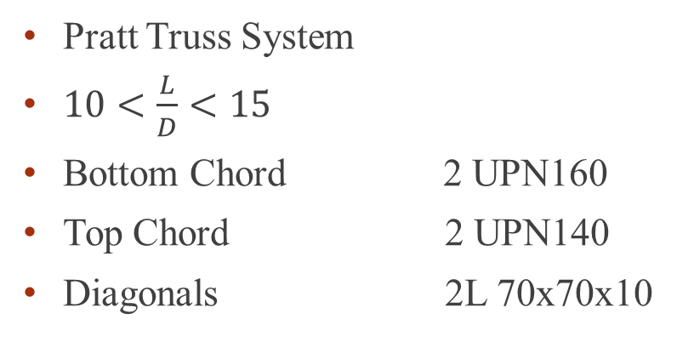
Pratt Truss System
$10<\frac{L}{D}<15$
Bottom Chord 2 UPN160
Top Chord 2 UPN140
Diagonals 2L 70x70x10

Slide 20
SLAB DESIGN and ALTERNATIVES

Slide 21
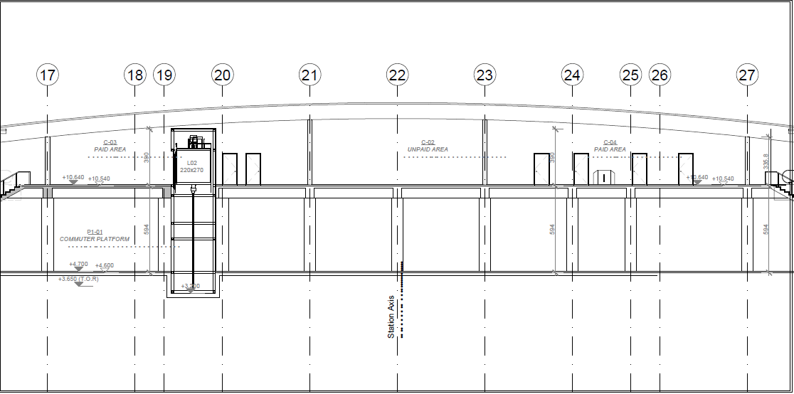

Slide 22
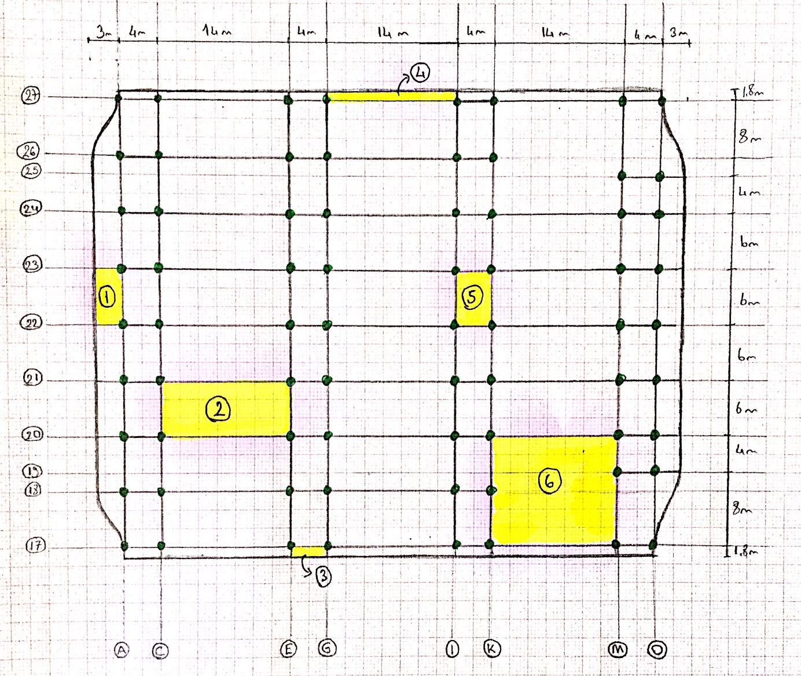
Beam - Slab Plan

Slide 23
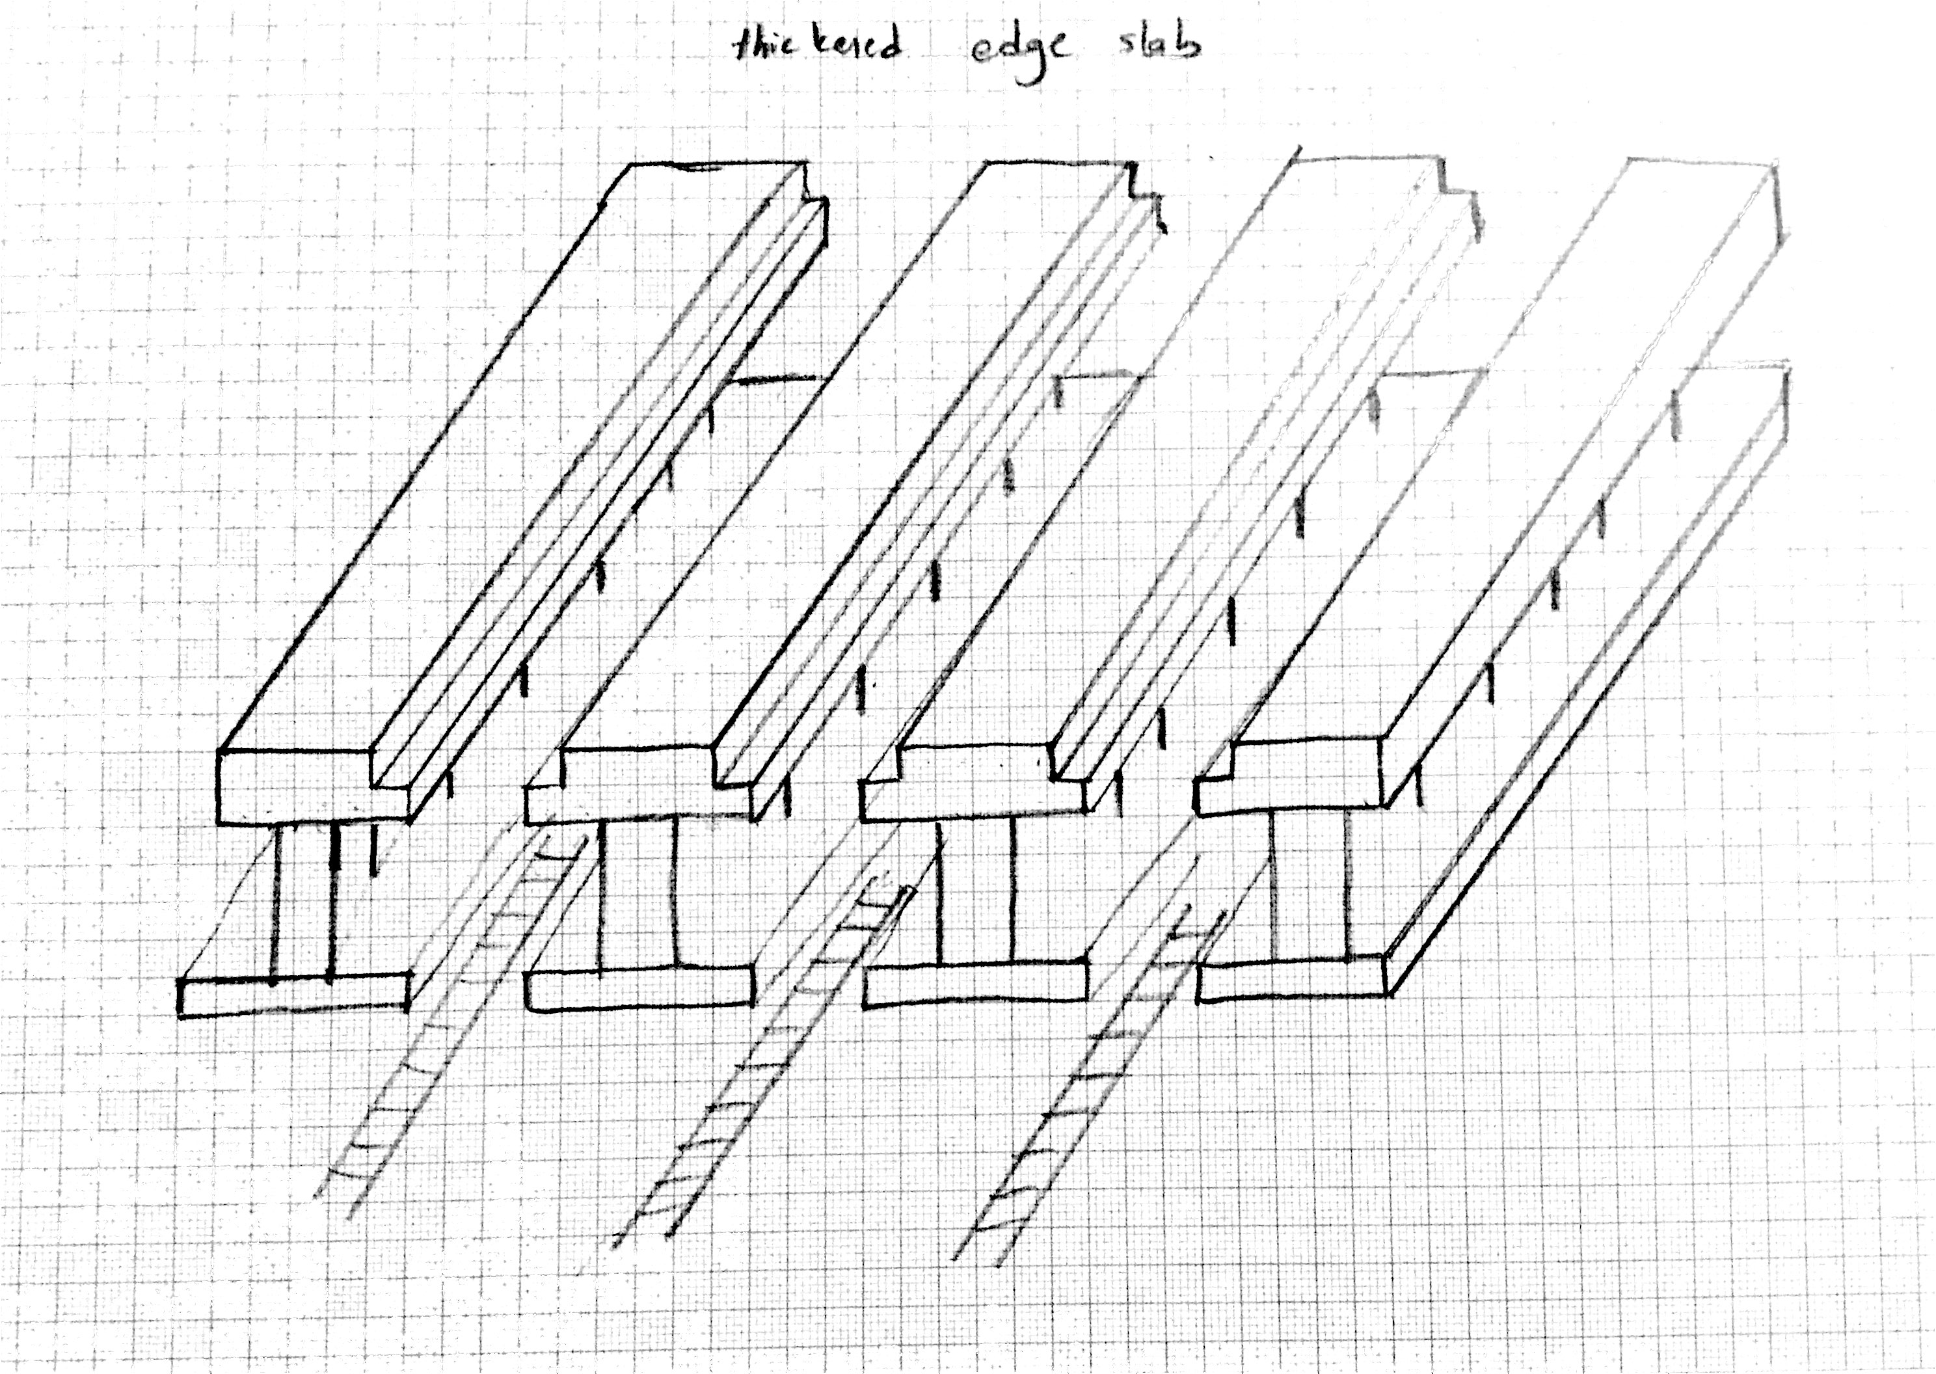
DÜZELTİLCEK

Slide 24
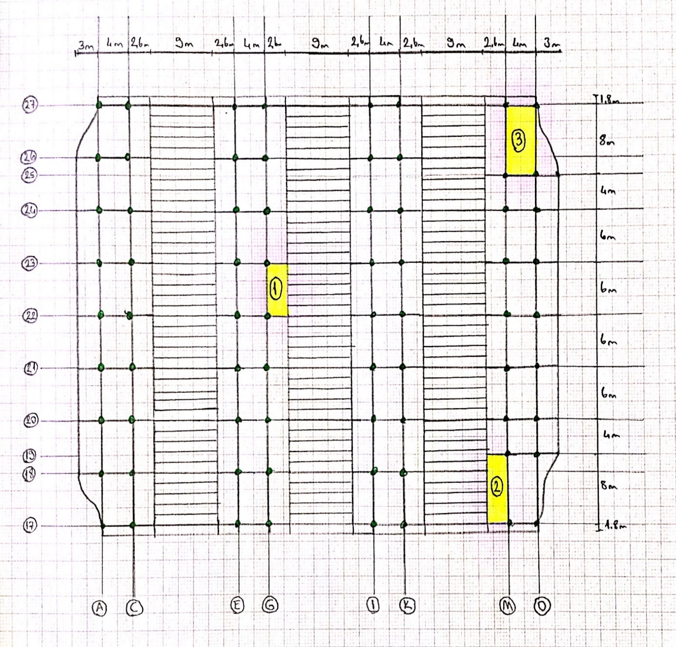
Precast - Slab

Slide 25
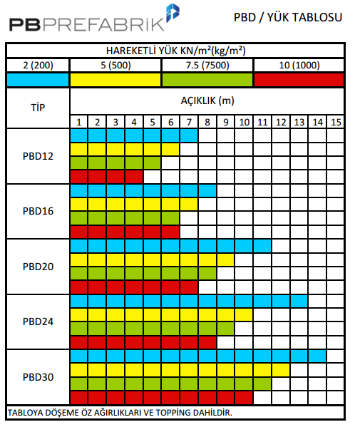
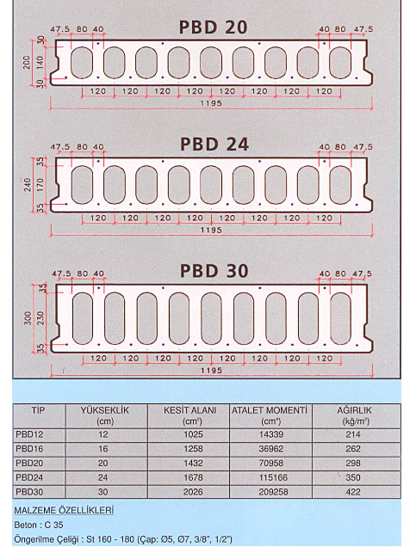
(http://www.pbprefabrik.com.tr/assets/documents/bdp.jpg)

Slide 26
Hollow-core slab (precast)
Lower self weight
Less material
Higher load carrying capacity
Mass production opportunity
Not affected by severe climate conditions

Slide 27
COLUMN DESIGN

Slide 28
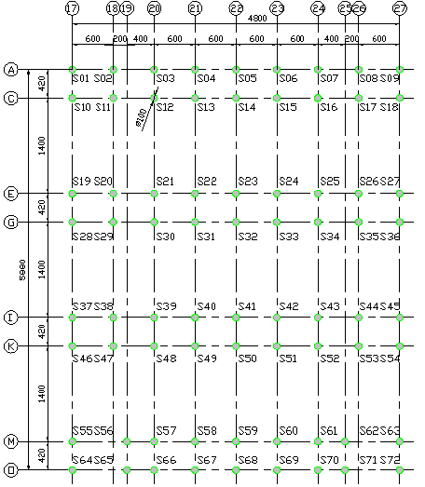
Ground Floor Columns

Slide 29
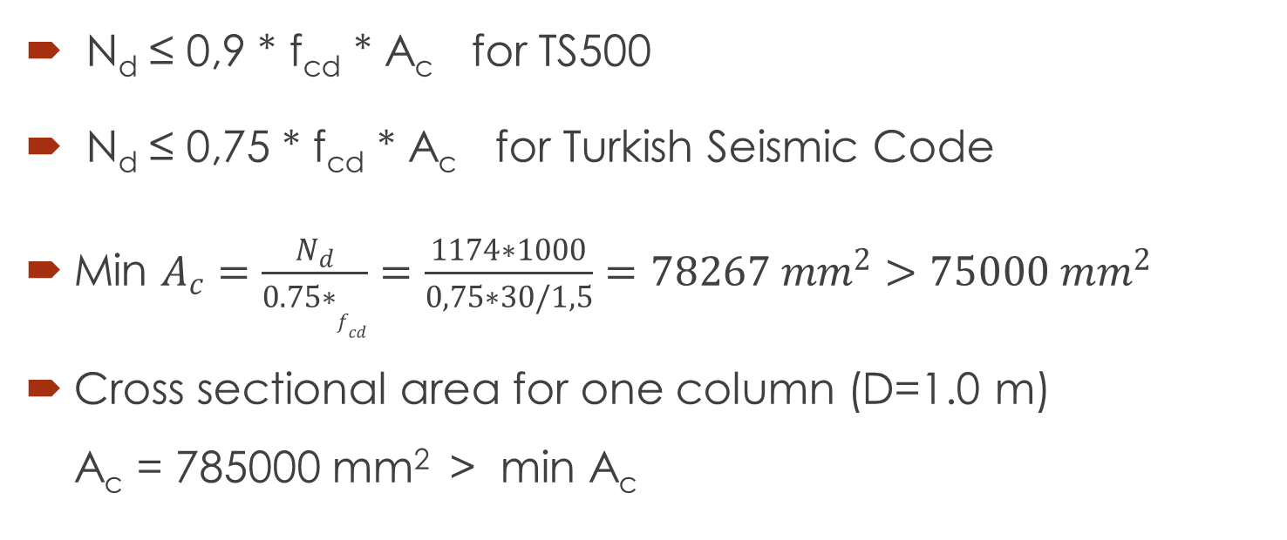
N_{d} ≤ 0,9 * f_{cd} * A_{c} for TS500
N_{d} ≤ 0,75 * f_{cd} * A_{c} for Turkish Seismic Code
Min $A_{c}=\frac{N_{d}}{0.75∗f_{cd}}=\frac{1174∗1000}{0,75∗30/1,5}=78267 {mm}^{2}>75000 {mm}^{2}$
Cross sectional area for one column (D=1.0 m) A_{c} = 785000 mm² > min A_{c}

Slide 30
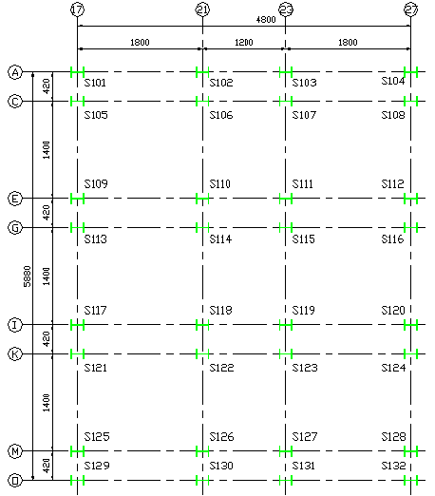
First Floor Columns (Steel Column Case)

Slide 31
First Floor Columns (R.C. Case)

Slide 32
GEOTECHNICAL PROPERTIES and FOUNDATION DESIGN

Slide 33
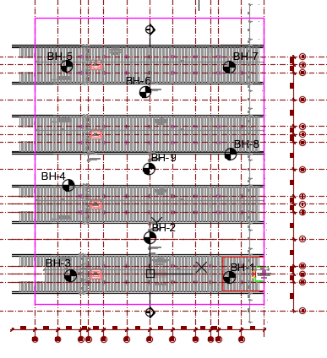
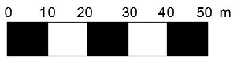
Site Investigation
I.Boreholes
No. Of Borehole (BH) | Depth (m)
BH-1 | 30.00
BH-2 | 25.00
BH-3 | 30.00
BH-4 | 25.00
BH-5 | 30.00
BH-6 | 25.00
BH-7 | 25.00
BH-8 | 30.00
BH-9 | 15.00

Slide 34
II. Soil Parameters
Group Symbol | Clay (CH, CL) & Silt (MH, ML)
Water Content | w(%) = 15.2 – 40.9 => Estimated Value of w(%) = 26.0
Plasticity Index | PI(%) = 50.8 – 96.3 => Estimated Value of F(%) = 23.0
UnitWeight (kN/m³) | ɣ(%) = 16.07–20.30 => Estimated Value of ɣ(%) = 18.5 kN/m³
Description | c_{u} (kPa) | Ф_{u} | c’ (kPa) | Ф’ | ɣ (kN/m³) | m_{v} (m²/kN) | E_{u} (kPa)
Silty Clay | 200 | 0 | 15 | 28 | 18.5 | 0.40*10⁻⁴ | 45000

Slide 35
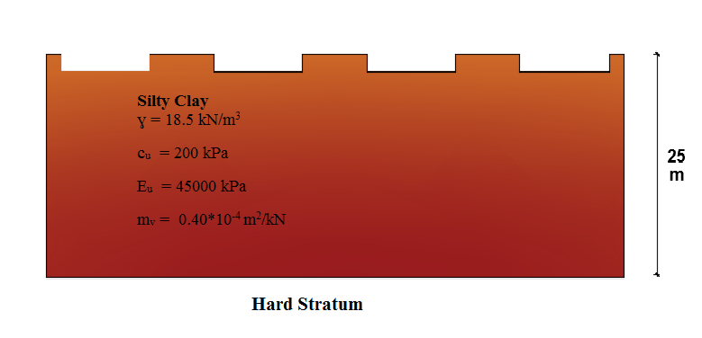
III. Idealized Soil Profile
Nort = 50
Stiff Soil No ground improvement

Slide 36
IV. Foundation Type
Type | Continuous Foundation
Width | 10.0 m
Thickness | 0.50 m
Length | 59.80 m
Area | 10*59.80 = 598 m²

Slide 37
Bearing Capacity
Structure | Type of Foundation | B*L (m) | N_{c} | c_{u}(kPa) | (q_{net})_{safe} (kPa) | ɣ*D_{f} | (q_{total})_{safe} (kPa)
Marmaray Station (on 4 platforms) | Continuous Foundation | 10.0* 59.8 | 5.2 | 200 | 347 | 37 | 384
Settlement
S_{total} = 0.089 cm acceptable

Slide 38
Cost Estimation
Unit price for a metro station 920,00 TL/m²
 | m² | Cost
Platform Area | 2167 | TRY 1,993,640.00
Concourse Area | 3308 | TRY 3,043,360.00
Roof Area | 3587 | TRY 3,300,040.00
 | Total | TRY 8,337,040.00

Slide 39
References
Birand,A., Ergun, U., & Erol, O. (2011). CE366 Foundation Engineering 1 Lecture Notes.
Carter, M., & Bentley, S. P. (1991). Correlations of Soil Properties. London: PENTECH PRESS.
CE363 Lecture Notes.
CE464 Lecture Notes.
DESIGN AND CONSTRUCTION SPECIFICATIONS FOR STEEL STRUCTURES by MINISTIRY OF ENVIORENMENT AND URBAN PLANNING (September, 2016)
Ersoy, U., Özcebe, G., & Tankut, T. Reinforced Concrete. Ankara: METU Press.
TS498-DESIGN LOADS FOR BUILDING.
TS500-REQUIREMENTS FOR DESIGN AND CONSTRUCTION OF REINFORCED CONCRETE STRUCTURES
TSC2007-TURKISH SEISMIC CODE.

Slide 40
QUESTIONS ?
THANK YOU…

